Slide 1
Topic: Review of rates and ratios
EQ: What do we know about rates and ratios.

Slide 2
Ratios are used to compare quantities with the same units.
The ratio of 2 to 5 is written as 2 : 5
If there are 15 green cars, 3 red cars and 4 blue cars
a) what is the ratio of blue cars to green cars?
b) What is the ratio of red cars to green cars?
c) What is the ratio of blue cars to total cars?
A toy company makes 6 rubber ducks and 5 dolls to every 2 toy drill.
a) Write this in a ratio of drills to ducks
B) drills to ducks to dolls
C) dolls to total

Slide 3
The trick with simplifying ratios is to always multiply or divide the numbers by the same number.
Simplify a) 12:24 b) 36:18 c) 8:102
4) A recipe requires 4 cups of water to 6 cups of flour. Write this in its simplest form.
5) The ratio at a conference is 2 girls to every 3 boys, how many girls are there if there are 120 boys?
6) If a blend of coffee requires 3g of arabica beans to 4g of robusta, How many grams of arabica do I need if I use 48g of robusta and what is the total weight?

Slide 4
Think of a ratio in terms of parts. A ratio of 2 : 3 has a total of 5 parts.
To split a number by a ratio use the following procedure:
Find the total number of parts in the ratio.
Find the value of one part.
Find the valve of the number of parts.
7) Split $100 in the ratio of 4:6
8) A class has 32 students in a ratio of 7 boys : 9 girls. How many boys are there?
9) Marco owns 30% of a company, Julia owns 60% and Julio owns 10%.
a) write this as a ratio
b) the company earns $10,000 profit on a contract. How much does each person get?

Slide 5
A rate compares related quantities with different units.
Rates are usually written with one quantity compared to a single unit of the other.
km/hr $/hr $/kg L/min beats/min goals/game
Write the following as rates
a) driving 450km over 9 hours
b) getting paid $150 for 6 hours work
c) Filling a 9 litre bucket in 30 seconds
d) Scoring 90 pts over 5 games of basketball
e) Writing 1200 words over 60 minutes

Slide 6

To find the rate we need to work out what one of that unit will be.
To do this we need to divide both numbers by the second number
Now simplify the following as rates with the units in the brackets
a) driving 450km over 5 hours (km/hr)
b) getting paid $150 for 5 hours work ($/hr)
c) Filling a 9 litre bucket in 2 minutes (l/min)
d) Scoring 110 pts over 5 games of basketball (pts/game)
e) Writing 1800 words over 2hours (words/min)
f) 3kg of apples for $15 ($/kg)

Slide 7
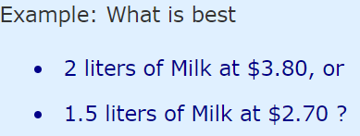
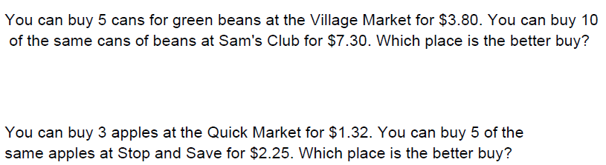


Comparing Unit Prices can be a good way of finding which is the "best buy"
$$=\$1.90 per Litre$$
$$=\$1.80 per Litre$$

